Slide 1
TUTORIALS
ME 282

Slide 2
QUESTION 1
(a) Convert the [111] direction into the four-index system for hexagonal crystals.
(b) Draw this direction within a ruled-net coordinate system

Slide 3
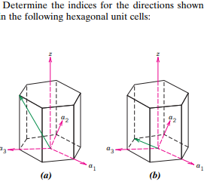
QUESTION 2

Slide 4
QUESTION 3
Calculate the linear density of the following directions:
[110] BCC R=2.34A⁰
[111] BCC R=0.897A⁰
[-121] FCC R=0.476A⁰
[011] SC R=3.42A⁰

Slide 5
QUESTION 4
Calculate the Planar density of the following planes given that R= 2.867A⁰ :
(110) FCC
(111) BCC
(-100) SC

Slide 6
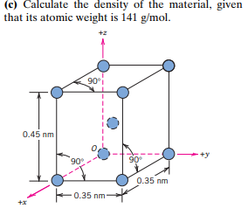
QUESTION 5

Slide 7
QUESTION 6
Calculate the radius of Palladium atom, given that Pd had FCC crystal structure, a density of 12.0g/cm3 and atomic weight of 106.6g/mol. [NA= 6.023x10²³ atoms/mol]

Slide 8
QUESTION 7
The density of potassium, which has the BCC structure, is 0.855g/cm3. The atomic weight of potassium is 39.09g/mol. Take Avogadro’s constant as 6.023x10²³ atoms/mol.
Calculate:
Lattice Parameter
Atomic Radius

